Slide 1
Analyzing Customers Personality for Business Improvement using Machine Learning
Presented by :
A Sai Teja(18841A1203)
S Manikanta(18841A1231)
Name of the Guide:
Ms. M Vineela

Slide 2
ABSTRACT
Comprehensive investigation of a company's ideal clients is known as a customer personality analysis. It aids a company's understanding of its consumers and makes it simpler to change goods to meet the demands, habits, and concerns of various sorts of customers.
Customer personality analysis enables a company to adapt its product depending on the preferences of its target customers from various customer categories. Instead of paying money to promote a new product to every client in a firm's database, for example, a company may determine which customer group is most likely to buy the product and then market it to that segment solely.
Hence, the main motive is to find the accuracy of the prediction of the personality of the customer who is shopping and improve the research out there.

Slide 3
Existing Systems:
In the existing system they are using SVM or KNN are used to analyzing the customer personality.
With the help of one algorithm support we are getting less accuracy.
A single Machine Learning algorithm have constraints less optimal forecast.
Getting high accuracy is very difficult.

Slide 4
Proposed System:
The proposed system using k-means clustering algorithm to get a high accuracy
With this algorithm we can analyze the dataset easily and can take decisions to improve business.

Slide 5
MODULES
Data Collection
Data Preprocessing
Splitting Dataset
K-means Clustering
Training Data
Testing Data / Prediction

Slide 6
LITERATURE REVIEW:
JOURNAL : International Journal of Engineering & Technology-2020
TITLE : Personality prediction using Machine Learning
AUTHOR : Madarapu Soumica
DESCRIPITION :
According a research ML in particularly two ways will be helpful to us in the prediction of the personality analysis. Firstly, by predicting values through the available datasets through which with are going to predict further predictions because it gives the data regarding the recent trends for our research. Secondly ML methods could allow us with the insights from personality psychology to be translated to practical applications in a more reliable way. There are other cross validation methods to provide us with more realistic estimation for how much accurate the model going to be. The usage of Personality prediction is going to be very useful in the near future as it will give us an idea about the customer expectation towards a product which will be beneficial especially for product-based companies.

Slide 7
LITERATURE REVIEW:
JOURNAL : International Journal of Research Technology & Engineering-2019
TITLE : Customer personality prediction using ANN
AUTHOR : Bobbili Siva Rama Krishna
DESCRIPITION :
Another study says ANN method will be helpful for the personality prediction from social media platforms like Facebook. Since lots of data of a person is already stored in a social media platform it is not even hard to predict anyone’s emotion, likes and dislikes through that data. But that’s the only limitation of this algorithm that should have enough data for the prediction.

Slide 8
LITERATURE REVIEW:
JOURNAL: International Journal of Engineering & Technology-2018
TITLE : Customer personality prediction based on SVM & XGBoost
AUTHOR : Chamarthi Somashekhar Varma
DESCRIPITION :
Same as Facebook, Twitter also uses their data to predict people’s behaviour by analysing their no. of followings and followers, no. of favourite tweets, their regular activities …etc. And on that basis, twitter suggests people to which page or person they should follow and gives its prediction about their likes and dislikes. And according to research there was a comparison between SVM method and XGBoost algorithm in which SVM gave 76.23% accuracy and XGBoost resultant 97.99% highest accuracy.

Slide 9
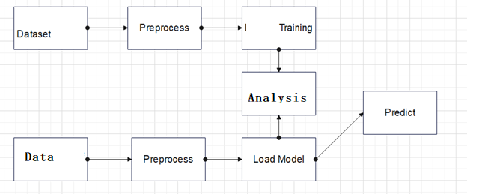
SYSTEM ARCHITECTURE

Slide 10
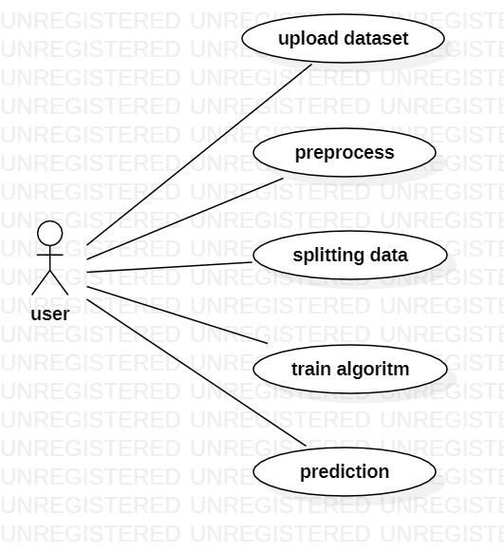
Use Case Diagram:

Slide 11
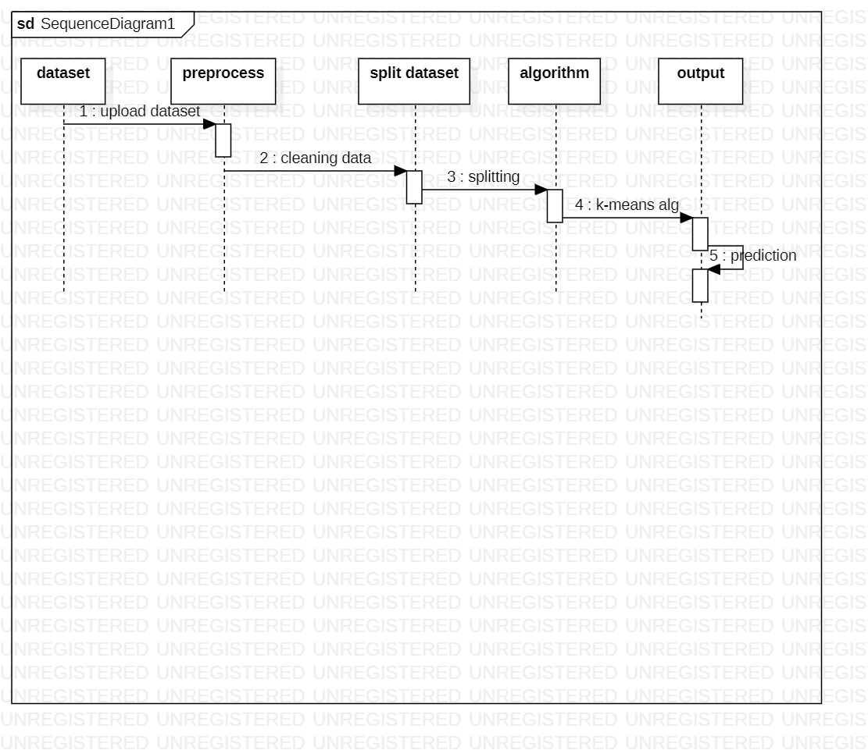
Sequence Diagram:

Slide 12
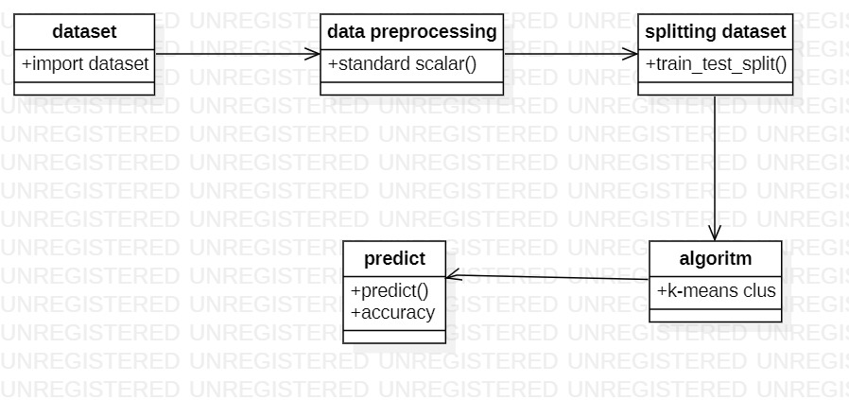
Class Diagram:

Slide 13
CONCLUSION:
Customers are the primary income for the business and without them the business won’t be able to survive in this competitive era. Hence, knowing what the customer wants based on his personality and likings makes the company’s task easy to target him with that product and get him to buy that product. So, the k-means clustering model used by us gave an accuracy of ~99 percent, which would help many companies take this and apply it in their business.

